Slide 1
Normal Forms

Slide 2
Third Normal Form (3NF)
3NF is based on the concept of transitive dependency.
A relation is in third normal form, if there is no transitive dependency for non-prime attributes as well as it is in second normal form.
A relation is in 3NF if at least one of the following condition holds in every non-trivial function dependency X –> Y
X is a super key.
Y is a prime attribute (each element of Y is part of some candidate key).

Slide 3
Third Normal Form (3NF)
A relation that is in First and Second Normal Form and in which no non-primary-key attribute is transitively dependent on the primary key, then it is in Third Normal Form (3NF).

Slide 4
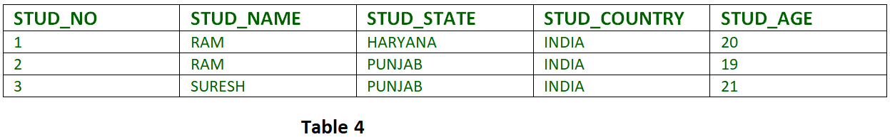

Slide 5
{STUD_NO -> STUD_NAME,
STUD_NO -> STUD_STATE,
STUD_STATE -> STUD_COUNTRY,
STUD_NO -> STUD_AGE}
Candidate Key: {STUD_NO}
For this relation in table 4, STUD_NO -> STUD_STATE and STUD_STATE -> STUD_COUNTRY are true. So STUD_COUNTRY is transitively dependent on STUD_NO. It violates the third normal form.
To convert it in third normal form, we will decompose the relation STUDENT
STUDENT (STUD_NO, STUD_NAME, STUD_PHONE, STUD_STATE, STUD_AGE)
STATE_COUNTRY (STATE, COUNTRY)

Slide 6
Boyce-Codd Normal Form (BCNF)
Boyce-Codd Normal Form or BCNF is an extension to the third normal form, and is also known as 3.5 Normal Form.
Rules for BCNF
For a table to satisfy the Boyce-Codd Normal Form, it should satisfy the following two conditions:
It should be in the Third Normal Form.
And, for any dependency A → B, A should be a super key.
The second point sounds a bit tricky, right? In simple words, it means, that for a dependency A → B, A cannot be a non-prime attribute, if B is a prime attribute.
A relation is in BCNF, if and only if, every determinant is a Form (BCNF) candidate key.

Slide 7
Example - Class_Test(Student_id, Professor_id, Class_code, Student_grade)
Functional Dependecy (Student_id, Professor_id) → (Class_code, Student_grade) Class_code → Professor_id>

Slide 8
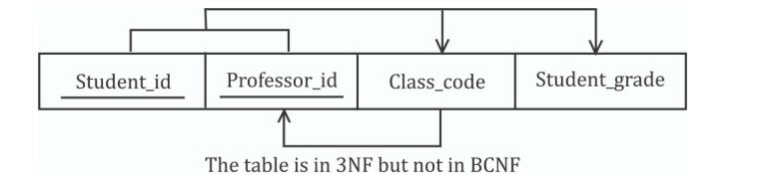

Slide 9
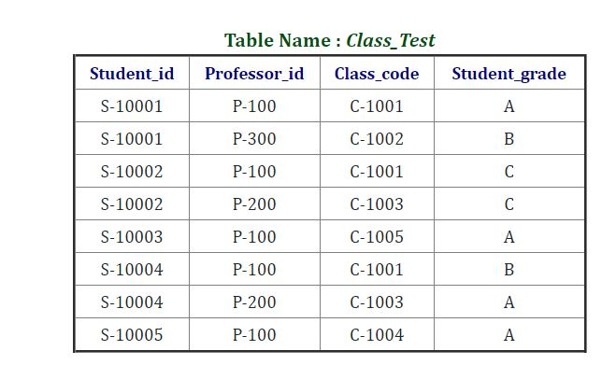

Slide 10
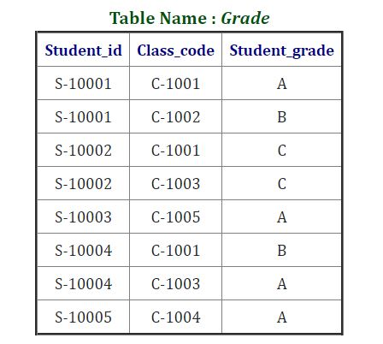

Slide 11
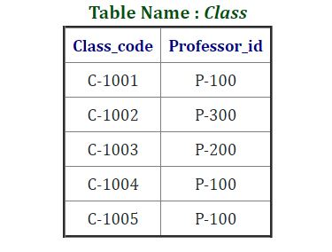

Slide 12
student_id | subject | Professor Name
101 | Java | Alex
101 | C++ | Amit
102 | Java | Alex
This table satisfies the 1st Normal form because all the values are atomic, column names are unique and all the values stored in a particular column are of same domain.
Candidate Key Student_id –>Subject, Professor name
Professor name –> Subject
This table also satisfies the 2nd Normal Form as their is no Partial Dependency.
And, there is no Transitive Dependency, hence the table also satisfies the 3rd Normal Form.
But this table is not in Boyce-Codd Normal Form.

Slide 13
Why this table is not in BCNF?
In the table above, student_id, subject form primary key, which means subject column is a prime attribute.
But, there is one more dependency, professor → subject.
And while subject is a prime attribute, professor is a non-prime attribute, which is not allowed by BCNF.

Slide 14
How to satisfy BCNF?
To make this relation(table) satisfy BCNF, we will decompose this table into two tables, student table and professor table.
Below we have the structure for both the tables.
Student Table
student_id | Professor Name
101 | Alex

Slide 15
Professor Table
Professor Name | Subject
Alex | Java
Amit | C++

Slide 16
Fourth normal form (4NF)
A relation will be in 4NF if it is in Boyce Codd normal form and has no multi-valued dependency.
For a dependency A → B, if for a single value of A, multiple values of B exists, then the relation will be a multi-valued dependency.

Slide 17
Student
STU_ID | COURSE | HOBBY
21 | Computer | Dancing
21 | Math | Singing
34 | Chemistry | Dancing
74 | Biology | Cricket
59 | Physics | Hockey

Slide 18
The given STUDENT table is in 3NF, but the COURSE and HOBBY are two independent entity. Hence, there is no relationship between COURSE and HOBBY.
In the STUDENT relation, a student with STU_ID, 21 contains two courses, Computer and Math and two hobbies, Dancing and Singing. So there is a Multi-valued dependency on STU_ID, which leads to unnecessary repetition of data.
So to make the above table into 4NF, we can decompose it into two tables:

Slide 19
STUDENT_COURSE
STU_ID | COURSE
21 | Computer
21 | Math
34 | Chemistry
74 | Biology
59 | Physics

Slide 20
STUDENT_HOBBY
STU_ID | HOBBY
21 | Dancing
21 | Singing
34 | Dancing
74 | Cricket
59 | Hockey

